Slide 1
Questions across cultures
Activity created by Dr. Kris Acheson-Clair, Dr. Alankrita Chhikara, and Kelsey Patton, CILMAR.
Ting-Toomey, S., 1999. Communicating Across Cultures. Guilford, New York.
Ting-Toomey, S., & Chung, L. C. (2022). Understanding Intercultural Communication. Oxford University Press.

Slide 2
Questions across cultures
Curiosity
How do you understand and define curiosity?
Is curiosity always positive? When could curiosity be negative?
Why do we ask questions of others? What is the purpose of questions?

Slide 3
Questions across cultures
How do you feel when questions are asked of you about identities with which you identify (ethnicity, race, gender, sexuality, etc.)?
What contextual factors are important when evaluating how you feel about these questions? Does how you feel change based on how or why the questions are asked?

Slide 4
Questions across cultures
Curiosity defined within an intercultural competence context:
“To ask complex questions about other cultures. To seek out and articulate answers to these questions that reflect multiple cultural perspectives.”
(AAC&U VALUE Rubric)

Slide 5
Questions across cultures
“To ask complex questions about other cultures. To seek out and articulate answers to these questions that reflect multiple cultural perspectives.” (AAC&U VALUE Rubric)
What do you think about this definition? Would you add/subtract/modify anything? How useful is it for intercultural learning?
What does this cultural curiosity have in common with scientific or artistic curiosity? How important is curiosity to your discipline?
Why is curiosity not only an important mindset for interacting across cultures, but also key to career skills?

Slide 6
Questions across cultures
We often speak of curiosity as a positive trait we are working to grow…
In what ways are motives and curiosity related?
Can curiosity have negative motives? What is an appropriate motive in your opinion? What is an inappropriate motive?
Can curiosity do damage even when motives are pure?

Slide 7
Questions across cultures
https://www.youtube.com/watch?v=-ZkphjQUvzc
Notes:
Facilitator notes: This is one example (among many) you can use. Feel free to insert a different clip (or meme) from your personal knowledge or from the lesson plan.
Ask participants to keep the previous discussion in mind while watching this video.

Slide 8
Questions across cultures
Consider the following questions…
What is the story behind your name?
What are you interested in that most outsiders to your culture haven’t heard of?
What are you most looking forward to in the next 10 years? Are there cultural milestones that are expected of you? If so, which ones?
When do you feel truly alive? Does your culture approve of this?
What are three interesting facts about you that make you stand out as different from others in your cultural group?
How many and which languages are you able to communicate in? Is multilingualism common where you are from?
What is your favorite book/movie/tv show/song? Is this popular in your community?
What would your last meal on Earth be? Is this meal closely associated with your culture? If so, how?
Notes:
Facilitator notes: Ask participants to consider these questions within the context of the YouTube video/meme reviewed earlier in the activity, making note of their personal feelings, thoughts, observations, questions, etc. Give students a few minutes to ponder these questions silently.

Slide 9
Questions across cultures
What differences/similarities/themes among questions do you notice?
What do you notice about the tone of the questions? How would you read the questions out loud?
What do you notice about the language used in the questions?
Notes:
Facilitator notes: Ask participants to compare and contrast the questions from the video to the questions from the previous slides. You can go back and forth between this slide and the previous slide to keep the questions fresh on participants’ minds as they reflect.

Slide 10
Questions across cultures
What role does power play in the questions? Is there implied power in the questions? How so?
Does the question-asker ask the question as if they have the right to know something?

Slide 11
Questions across cultures
Does the question-asker already possess the insight or knowledge they are asking about? Are they simply confirming what they think they know?
Are there any offensive assumptions/implied stereotypes present in the questions? Where?

Slide 12
Questions across cultures
Think of a time you’ve been asked an inappropriate question.
How did you feel? What made the question inappropriate?

Slide 13
Questions across cultures
Think of a time you’ve asked an inappropriate question.
What led you to ask this question? What was at the heart of your question? How would you approach the situation differently as the question-asker?

Slide 14
Questions across cultures
Rate yourself from 1-10 on how comfortable you are interacting with people culturally different from you, with 1 being extremely uncomfortable and 10 being extremely comfortable.
Notes:
Facilitator notes: You can have participants reflect silently or share their number if your group seems open to this.

Slide 15
Questions across cultures
What do you believe the cause of comfort/discomfort felt in cross-cultural situations is (e.g., fear, etc.)?

Slide 16
Questions across cultures
Effective
Appropriate
Satisfactory
(Ting-Toomey, 1999)
Notes:
Facilitator notes: Introduce the concept of E-A-S to participants.

Slide 17
Questions across cultures
Effective
How would you define effective?

Slide 18
Questions across cultures
Effective
This is about your goal as a question-asker. Are you getting the information you are looking for?

Slide 19
Questions across cultures
Appropriate
How would you define appropriate?

Slide 20
Questions across cultures
Appropriate
This means your question follows cultural rules and norms on a societal level and does not violate anyone’s expectations of politeness.

Slide 21
Questions across cultures
Satisfactory
How would you define satisfactory?

Slide 22
Questions across cultures
Satisfactory
“(T)o the extent that the important identities (e.g., cultural or gender) of the intercultural communicators have been positively addressed and sensitively dealt with, they will experience interaction satisfaction.” (Ting-Toomey, 1999, p. 265).

Slide 23
Questions across cultures
Satisfactory
This is the impact a question has on an individual. It involves supporting and validating their identity and taking care of their needs in the questions we ask (e.g., avoiding making people feel like you’ve negatively stereotyped them, not putting pressure on people to talk about things that are deeply personal that they don’t want to share).

Slide 24
What questions should we ask ourselves before asking a question?
Effective
Notes:
Facilitator notes: Ask participants what questions we should ask ourselves before asking a question to ensure it is effective. You can either instruct participants to fill in their ideas on a Jamboard (example in lesson plan) or have a class discussion and record answers on the white board or via shareable document to send to students later.

Slide 25
What questions should we ask ourselves before asking a question?
Appropriate
Notes:
Facilitator notes: Ask participants what questions we should ask ourselves before asking a question to ensure it is appropriate. You can either instruct participants to fill in their ideas on a Jamboard (example in lesson plan) or have a class discussion and record answers on the white board or via shareable document to send to students later.

Slide 26
What questions should we ask ourselves before asking a question?
Satisfactory
Notes:
Facilitator notes: Ask participants what questions we should ask ourselves before asking a question to ensure it is satisfactory. You can either instruct participants to fill in their ideas on a Jamboard (example in lesson plan) or have a class discussion and record answers on the white board or via shareable document to send to students later.

Slide 27
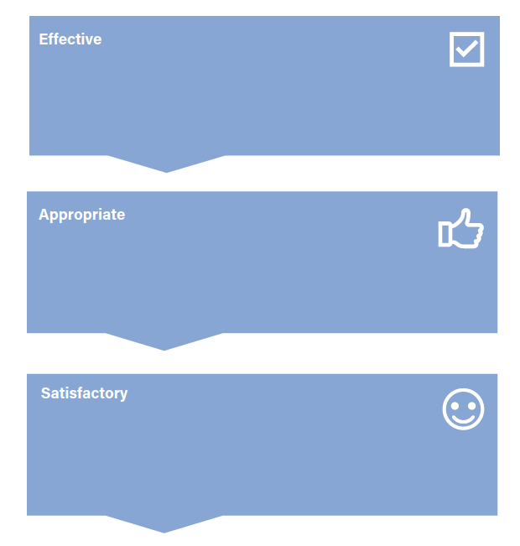
Questions across cultures
Notes:
Facilitator notes: Ensure participants have a physical copy of the Questions Across Cultures Handout. In the next slide, you will show participants a video clip scenario to analyze that includes a question that is not effective, appropriate, or satisfactory. Instruct participants to analyze the question(s) through their new E-A-S lenses, using the Questions Across Cultures Handout to take notes. In each box (one for E, one for A, and one for S), ask participants to list what made or did not make the question presented Effective, Appropriate, and Satisfactory. Ask participants to also note an alternative question(s) that could be asked instead of the question(s) presented in the video. Lastly, engage students in a group discussion on their individual notes from the handout.

Slide 28
Questions across cultures
https://www.youtube.com/watch?v=IgmB9c29UKU&
Notes:
Facilitator notes: This is one example (among many) of a clip you can use. Feel free to insert a different clip from your personal knowledge or from the lesson plan.

Slide 29
Questions across cultures
Notes:
Facilitator notes: Instruct participants to analyze the question(s) through their new E-A-S lenses, using the Questions Across Cultures Handout to take notes. In each box (one for E, one for A, and one for S), ask participants to list what made or did not make the question presented Effective, Appropriate, and Satisfactory. Ask participants to also note an alternative question(s) that could be asked instead of the questions presented in the video. Lastly, engage students in a group discussion on their individual notes from the handout.

Slide 30
Questions across cultures
Pair up.
Imagine you are on a team with someone culturally different from you and you would like to get to know them. Keeping in mind the importance of E-A-S questions, identify 3 question you’d ask your teammate.
*Think about information you might need to know about a team member so the team can work together more effectively (values, goals, communication/conflict styles, etc.).
Notes:
Facilitator notes: You can allow participants to browse the internet for ideas and inspiration as well if you would like.

Slide 31
Questions across cultures
Let’s share and provide constructive feedback!
Notes:
Facilitator notes: Instruct participants to listen to the questions of their peers with critical ears and to appropriately challenge one another where necessary, as well as provide encouraging feedback where applicable.

Slide 32
DEBRIEF
What did this activity bring up for you emotionally?
Which part of the activity was most impactful for you?
What is one thing you learned from this activity that you would like to incorporate into your interpersonal relationships? Does this activity change anything about the way you want to interact with people personally or professionally?

Slide 33
DEBRIEF
If you ask a question in the future that you realize later (or in the moment) is not an E-A-S question, what actions will you take (either in the conversation or as follow up to the conversation)? What could an appropriate acknowledgement of your mistake look like?
If you are asked a question in the future that is not an E-A-S question, how do you want to respond?

